Slide 1
Department Safety Coordinator’s Seminar
Enterprise Risk Services/Environmental Health & Safety Tuesday, April 7, 2015

Slide 2
Agenda:
10:00 – 10:05 Welcome (Dan Kermoyan, EH&S)
10:05 – 10:25 Laboratory Safety Program Overview (Dan Kermoyan, EH&S)
      OSU Laboratory Safety Elements
      Laboratory Safety Assessments
      Program Recommendations
10:25 – 10:45 Chemical Inventory Guidelines (Lance Jones, EH&S)
      What should be included within your inventory?
      How do you file your chemical inventory?
10:45 – 11:00 Container Labeling Guidelines (Lance Jones, EH&S)
      Labeling of chemical and hazardous waste containers made easy
** 10-Minute Break **
11:10 – 11:20 Chemical Hygiene Plan (Andy Kenst, EH&S)
      Does your laboratory have a chemical hygiene plan?
      Have your employees received training?
11:20 – 11:30 Occupational Medicine Services (Ariel Leshchinsky, Student Health)
11:30 – 11:40 Dangerous Goods Shipping (Kent Lanning, EH&S)
11:40 – 11:50 Q & A; Future topics?

Slide 3
Laboratory Safety Program Overview
Dan Kermoyan, EH&S

Slide 4
Laboratory Safety Assessments
Drivers
Benefits
Regulatory visits increasing
Recent events
Granting Agencies
Accreditation
Our observations
Faculty needs help
Compliance and lower fines
Reduce injuries and damages
Increase Research $$
Favorable exposure
Decrease chemical and disposal costs
EH&S as a resource

Slide 5
How do we get there……..?
Lab Categories (LCAT)
Laboratory categories grouped by materials used/stored.
1,618 spaces.
Assigned an assessment frequency.

Slide 6
Lab Spaces by Lab Category
These labs will be categorized as lab assessments are completed.
1,618
total
Annual inspections needed
Low
High
Risk and Activity Level

Slide 7
Lab Safety Assessment Process
1-month advanced notice to Department Chairs and Safety Coordinators.
Use Laboratory Safety Assessment checklist.
Common areas to focus on before EHS visit:
  Chemical inventory
  Label and secure chemicals & waste containers
  Training (SDS, Lab, Haz Waste)
  Lab Chemical Hygiene Plan

Slide 8
Lab Safety Assessment
Process
Lab Visit appointment with PI or Supervisor.
Nature of the Assessment?
  Resource oriented.
  2-way dialogue; feedback useful.
Lab Assessment Checklist: http://oregonstate.edu/ehs/
PI will receive Assessment Report via email.
  (Dept. Chair and Safety Coordinator copied)

Slide 9
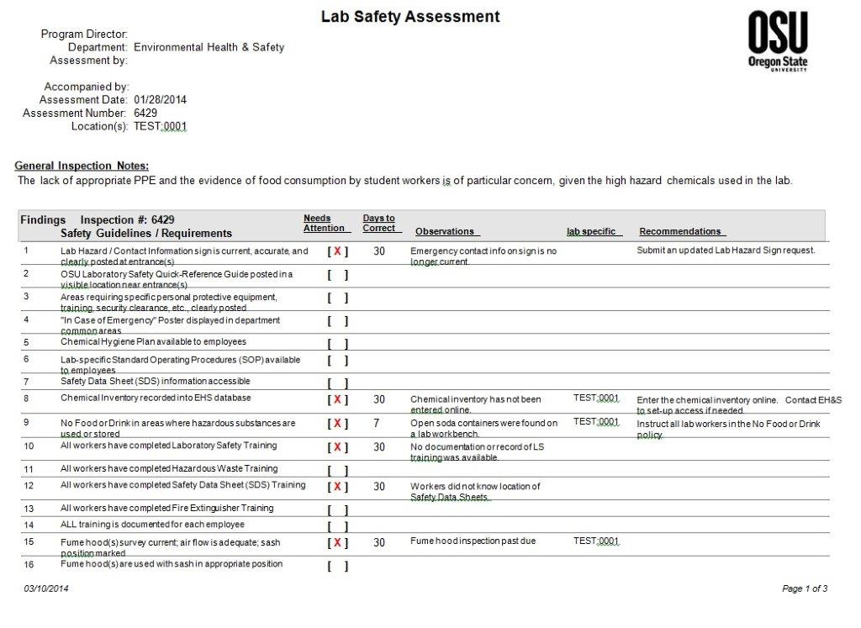

Slide 10
Lab Assessment: Actions Needed
Follow-up Times
Routine Items – Routine lab safety items.
  7 or 30 days
  No revisit by EH&S
Special Conditions – Special hazard exists.
  Less than 7 days
  Revisit by EH&S
Immediate Correction Needed – Imminent hazard exists.
  Immediate correction
  Revisit by EH&S

Slide 11
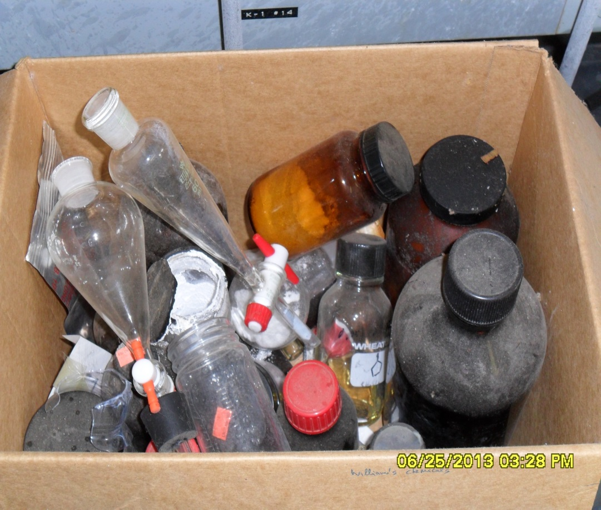
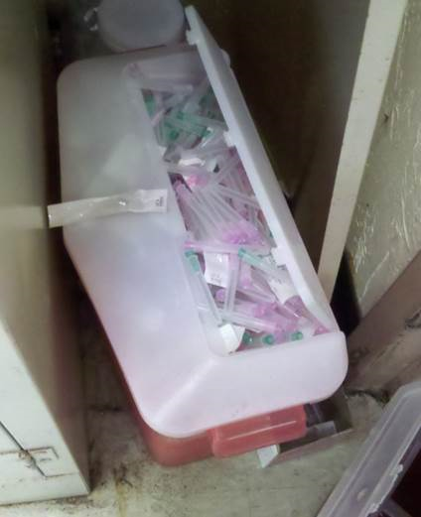
Actions Needed (w/i 7 days):
Special Conditions

Slide 12
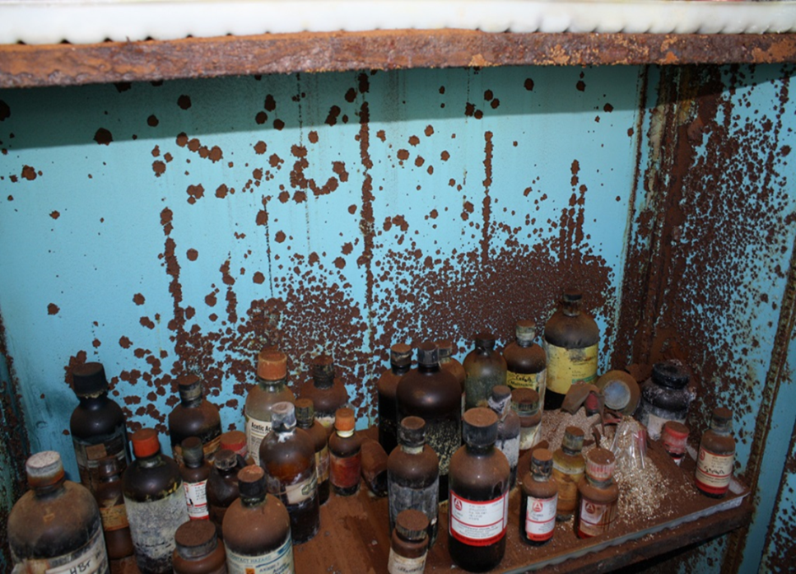
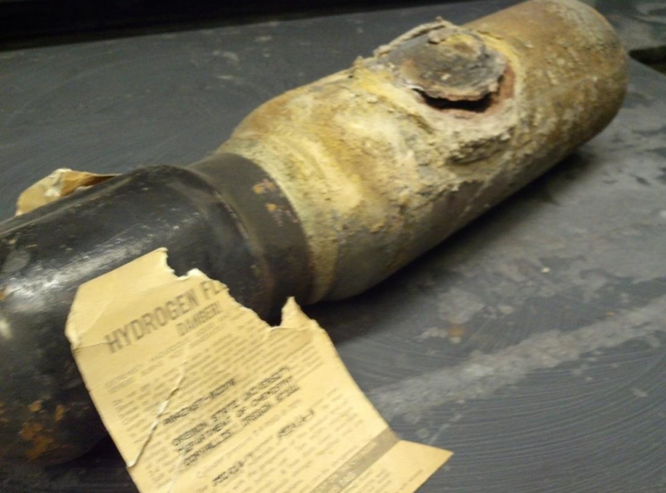
Actions Needed (immediately):
Imminent Hazards

Slide 13
Leading Deficiencies identified in 189 Lab Safety Assessments
627 Deficiencies noted in 189 Assessments
*Includes Chemical Container and Hazardous Waste Labeling

Slide 14
Responding to the Lab Safety Assessments
9% PI response rate for 2014 (using database).
PI can access the Assessment Results and enter corrections via the “Quick Links” drop down menu on the top/right side of the page at http://oregonstate.edu/ehs/.
Select “Record Actions Taken on Lab Safety Assessments”
Login with your ONID ID

Slide 17
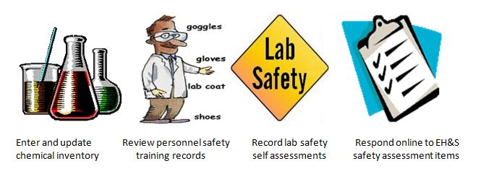
Program Recommendations
Annual Certification by the PI or Supervisor:
Verify lab personnel and spaces.
Review and update chemical inventories.
Label all chemical and hazardous waste containers.
Chemical Hygiene Plan is being maintained.
Lab staff have completed Lab Safety/SDS/Waste training.
Self-Assessment completed.
“PI Lab Safety Assistant”

Slide 18
Other Lab Program Recommendations
Test eyewashes w/i lab spaces monthly.
Formalize line of authority for training and program documentation.
Coordinated approach to repair and replacement of lab safety equipment.
30%
Chemical Fume Hoods are nearing their end of life and need replacement.
10%
10%
Lab Spaces need initial installation of eyewash units as none exist.
7%
Existing eyewash units need repair.
Safety Showers need repair.

Slide 19
Lab Assessment Schedules
Spring Term
Summer/Fall Term
Oak Creek
Crop Science
Burt
Wilkinson
Wiegand
Ag Field Stations
Engineering Depts.
Richardson
Peavy

Slide 20
Chemical Inventory Guidelines
Lance Jones, EH&S

Slide 22
Chemical Inventory Overview
Used as the basis of several reports
  Homeland security, CRTK (SFM), local FD
On-line with ONID access
  PI can set up others to access on their behalf
Drop-down search boxes (CAS#, chem name)
Can share list within department
Can export list (PDF, Excel, HTML)

Slide 23
Chemical Inventory Specifics
Location (from lookup)
Chemical description
Physical state
# of containers
Quantity per container
Unit of measure
CAS#

Slide 24
Inventory Data Integrity
Quality descriptors added to chemical name
  Sodium chloride, 99%
  Sodium chloride, crystalline
Punctuation or other characters in name or CAS#
  Silver (I) acetate vs. silver(I) acetate
  α,β
Size & unit of measure in same data field
  500g

Slide 25
Chemical Inventory - What to Exclude
Water and non-hazardous buffers, sugars, salts
Growth media
Biochemicals (non-toxic)
Commercial assay kits
Biological specimens
Radioactive materials counted on RUA
Waste
Retail products used in routine household-like manner

Slide 26
Chemical Inventory – What to Include
Full list of chemicals that must be included is on safety instruction Chemical Inventory Guidelines
Or
Include it all

Slide 27
Chemical Labeling Guidelines
Lance Jones, EH&S

Slide 28
NO!

Slide 29
Chemical Container Labels
What rules apply?
  Lab: OSHA lab standard
  Non-lab: OSHA haz-com standard

Slide 30
Chemical Container Labels
All containers need labels
Contents: required
  Plain English chemical name
Owner name: recommended
Date: required for certain materials
Hazard information
  Required for non-lab areas
  Recommended for lab areas
  HMIS or NFPA

Slide 31
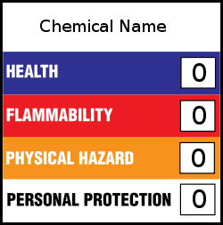

Hazard Information
HMIS format
NFPA format

Slide 32
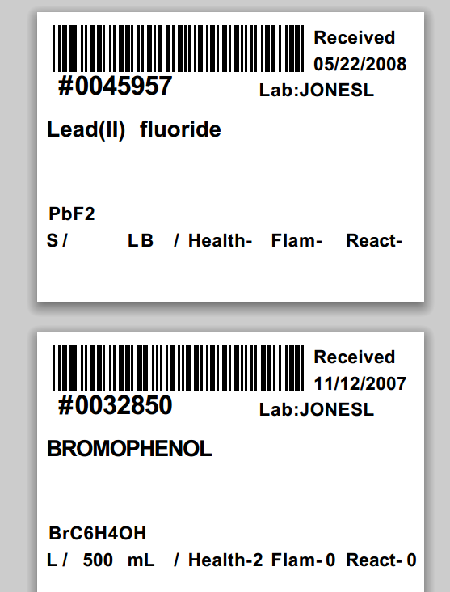
Pre-Printed Labels
Reports available online
  Standard formats (Avery)
  Label Printer (Zebra)
Barcode = Inventory #

Slide 33
Waste Labels

Slide 34
Questions?
10-Minute Break

Slide 35
Chemical Hygiene Plan
Andy Kenst, EH&S

Slide 36
OSU Chemical Hygiene Plan (CHP)
OSHA’s definition:
  The CHP is a written program stating the policies, procedures and responsibilities that protect workers from health hazards associated with hazardous chemicals used in a particular workplace.
Applies to all OSU labs and lab employees
  Lab Supervisors/Principal Investigators (LSs/PIs)
  Students
  Post-docs
  Lab techs and other laboratory staff
OSU CHP Addresses/Describes:
  Local, state and federal laws and regulations
  University policies and protocols
  OSU EH&S services and reference material
  Recommended best practices and other guidance

Slide 37
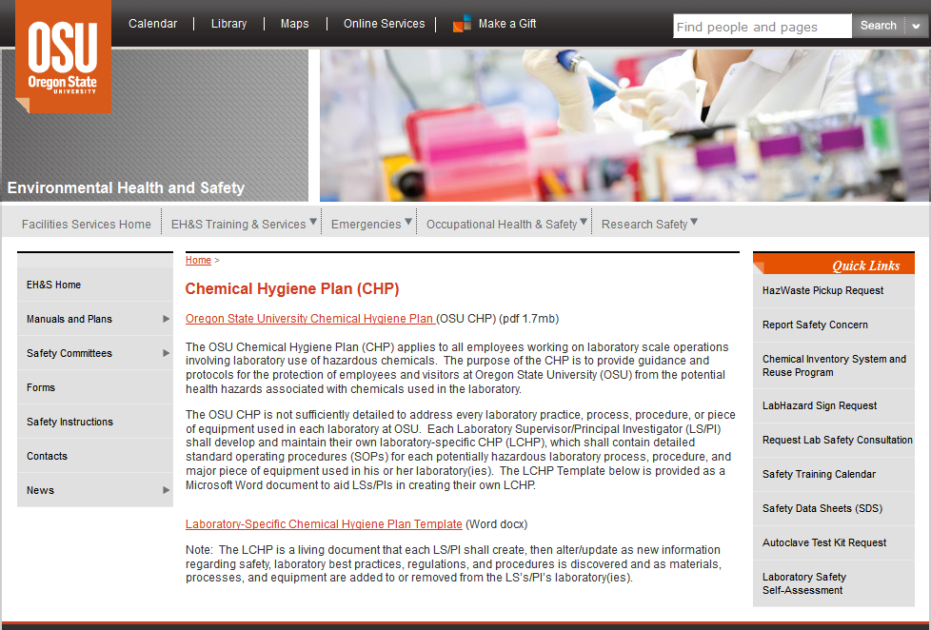
Lab-Specific CHP (LCHP)
OSU CHP is not sufficiently detailed to address all labs at OSU
Each PI must create an LCHP
  LCHP Template online
  Add lab-specific SOPs as Appendix IV
  Ensure workers have read and understood the LCHP with documentation
  Make LCHP and SOPs available for employee reference
  Periodically review and update the LCHP
http://oregonstate.edu/ehs/chp

Slide 38
Lab-Specific Chemical Hygiene Plan
Why maintain an LCHP?
  Improve lab safety through documented training/education
  It’s the law. OSHA requires it and may ask to see it when they visit.
  Resource for lab workers
  Regulatory agencies like the EPA want to see it used in labs.
  May help reduce liability in the event of an accident.

Slide 39
CHP and LCHP contents (in general)
Rights and responsibilities
General lab practices
Exposure monitoring and medical program
Procedures for accidents and emergencies
Personal Protective Equipment
Emergency equipment (eye wash, safety showers, first aid kits, etc.)
Employee training requirements and available resources
Record keeping
Working with carcinogens and highly toxic materials
Operations requiring prior approval (e.g., Institutional Biosafety Committee or Radiation Safety oversight)
Job Hazard Assessment and Standard Operating Procedure guidelines (written by LS/PI)
Forms, designated area signs, and supplemental chemical information

Slide 40
Occupational Medicine Services
Ariel Leshchinsky, Occupational Medicine

Slide 41
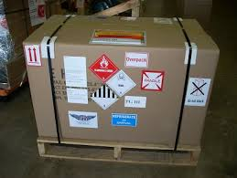
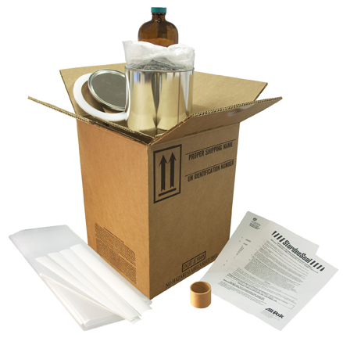

Shipping Dangerous Goods Through Printing and Mailing
Kent Lanning, EH&S

Slide 42
Shipping of Dangerous Goods (DG) by air or ground is regulated by the DOT/IATA and requires specific training.
Printing & Mailing handles shipments of DG for OSU.
Environmental Health & Safety provides technical and chemical expertise to Printing and Mailing.
There is substantial civil and criminal liability involved in shipping Dangerous Goods improperly.
NEVER ship something you suspect as a hazardous material without ensuring it is properly packaged and labeled. At OSU only specific personnel at EH&S and Printing & Mailing are qualified to do this.

Slide 43

In addition to ‘laboratory chemicals’ Dangerous Goods includes many common items that you can buy at a grocery store or hardware store but are considered regulated when being shipped.
Common examples of DG include:
Aerosol cans
Cleaners
Flammable Liquids
Corrosives
Batteries
Preserved or Diagnostic Specimens
Infectious Substances
Equipment containing any of the above

Slide 44
When Shipping DG through Printing and Mailing there are several things that will help your shipment go smoothly.
Identify whether the material is hazardous/non-hazardous before attempting to ship it. Listed materials are found in the 49CFR 172.101 Hazardous Materials Table. All hazardous materials have specific packaging, labeling, and handling requirements for shipping. When in doubt contact EH&S.
If you believe the material is hazardous contact Printing & Mailing or EH&S ahead of time to confirm what special packaging or handling is required.
Locate an SDS/MSDS for the material and provide it to Printing & Mailing when shipping materials. An SDS includes information on both hazards and specific shipping requirements for the material and makes shipping substantially easier.
Do NOT bring a sealed box with hazardous material inside to Printing & Mailing since it will have to be inspected by Printing & Mailing’s DG specialist to ensure compliance before being shipped.
Do NOT bring a DG shipment to Printing and Mailing half an hour before it needs to go out and expect it to ship. Most DG shipments will take 24 hours to process before shipment.

Slide 45
Consider alternatives to shipping DG
Dangerous Goods shipments are expensive, time consuming, and incur significant liability to the University.
FedEx, for example, adds an automatic $40 - $80 surcharge to dangerous goods shipments depending on the class of material. Special DG rated packaging for materials that require it add even more to this cost. This is in addition to the actual shipping cost.
Consider having the manufacturer of the material ship it directly to the destination for you. This removes liability from the University and is often cheaper as well.
Dangerous Goods can often be shipped in very small amounts under the ‘Excepted Quantities’ rule. This means they wont be considered DG and wont require special packaging or a surcharge. A 100ml bottle of a flammable liquid would require rated packaging and a DG surcharge but 4 bottles of 30ml or less in the same box wouldn’t. This would save close to $100 and be much quicker and easier to ship. Printing & Mailing or EH&S can look up a material and determine if Excepted Quantities can be applied.
Most DG packaging cannot be reused. If you received a chemical as Dangerous Goods it CANNOT be repackaged in the same cardboard box and reshipped or returned to the manufacturer. Even though the labeling and marking may be correct the container is not rated for multiple shipments. It is often cheaper to dispose of a chemical than return it to the manufacturer.

Slide 46
Summary For Shipping DG
Identify whether the item is a hazardous material ahead of time.
Contact EH&S/Printing & Mailing before shipping to determine if special packaging needs to be obtained and if the material might qualify for Excepted/Limited Quantities shipping.
Provide an SDS with the shipment to EH&S/Printing & Mailing or if the material does not have an SDS then information about the material’s hazards must be communicated by a knowledgeable person.
Bring the material to Printing & Mailing in a sturdy container to prevent leaks/spills during transit. Do not bring a sealed box or attempt to pack the material yourself.
Do not reuse old DG packaging. This includes repacking the material in the same box you received it in. Printing & Mailing will provide a new UN rated package with new labels for any shipment.

Slide 47
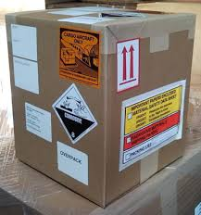
EH&S Contacts
Phone - 737-2273
Email - environment.safety@oregonstate.edu
Webpage – oregonstate.edu/ehs
Additionally EH&S personnel with specific shipping expertise can be contacted directly according to the matrix below:
Material to be shipped: Primary Contact: Secondary Contact:
Bio-Hazardous Materials Pete Schoonover Matt Philpott
737-3127 737-4557
Hazardous Materials Pete Schoonover Kent Lanning
737-3127 737-8359
Radioactive Materials Dan Harlan David Horn
737-7082 737-4060

Slide 48
Questions/Future Topics?
Presentation will be available for viewing at: http://oregonstate.edu/ehs/training
Thank You for Attending!

